Slide 1
DELE Reinforcement Learning
Singapore Polytechnic
P2100803
Haja Amir Rahman
P2112646
Justin Wong Juin Hng
Singapore Polytechnic

Slide 2
Table of contents
01.
03.
04.
02.
Singapore Polytechnic
Problem Breakdown
Modelling & Tuning
What are the requirements of the problem statement?
Initial Modelling and Hyperparameter Tuning
Conclusion
Research
Conclusion of Insights
Research into current RL
Algorithms
Singapore Polytechnic

Slide 3
Problem
Singapore Polytechnic
Apply a suitable RL architecture to the problem.
Land the Lunar Lander successfully on the landing pad
Singapore Polytechnic

Slide 4
Reinforcement Learning
Singapore Polytechnic
Subset of deep learning that deals with:
how an agent in an environment choose a sequence of actions in order to maximise a numerical reward signal.
It can also be said that RL is trying to find a balance between exploration and exploitation.
Exploration is a type of decision where the agent chooses to pick an action that it would not have done.
In contrast, exploitation is when the agent follows what it has always done.
OpenAI GYM:
Lunar Lander is one of OpenAI's gym environment where the agent is a lunar lander that tries to land on a landing pad at coordinate (0,0). These coordinate are the first 2 numbers in the state vector.
Singapore Polytechnic

Slide 5
Reinforcement Learning
Singapore Polytechnic
Discrete Actions:
Do nothing
Fire left orientation engine
Fire main engine
Fire right orientation engine
Observation Space:
X coordinate
Y coordinate
X Linear Velocity
Y Linear Velocity
Lander Craft Angle
Angular Velocity
If left leg is in contact with the ground
If right leg is in contact with the ground
Reward system of Lunar Lander:
Moving from the top of the screen to the landing pad at zero speed can range from 100 to 140 points.
If the lander moves away from the landing pad, it loses back the landing points.
The episode finishes if the lander crashes (receives -100 points) or comes to a rest (receives 100 points).
Each leg ground contact is an additional 10 points.
Firing main engine -0.3 reward per step.
From the above, we can conclude that the best episode would be the one where the lander lands (+20 for legs contact) and comes to rest (+100 for rest) on the center of the landing pad at zero speed (+140 for landing) with the least steps (+200 - (count_main_engine_fire * 0.3)).
Singapore Polytechnic

Slide 6
Modelling
Why DQN?
Improves stability and simplifies implementation.
Well-established and well-studied reinforcement learning algorithm with proven success.
Good starting point for solving reinforcement learning problems.
Makes algorithm more robust to changes in environment.
Especially useful for environments with constantly changing initial conditions, like Lunar Lander.
How does DQN work?
Initialize main and target Q-function networks.
Store experiences (state, action, reward, next state) in buffer.
Select random batch of experiences and update main network parameters.
Periodically sync target network parameters with main network.
Choose action based on current state and exploration policy.
Execute action, observe reward and next state.
Store experience in buffer.
Repeat steps 3-7 for fixed iterations or until agent performance meets criteria.
Use main network to estimate Q-values and choose action with highest Q-value.
Repeat steps 5-9 to interact with environment and continue learning.

Slide 7
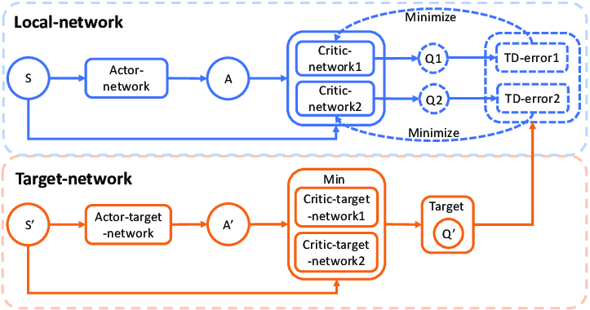
Modelling
Local vs Target Network Update Rate Tradeoff:
Local network: Constantly updated during the learning process to reflect the current estimates of the Q-function.
Target network: Updated periodically to provide a stable target for the local network to converge towards.
Faster local network updates result in quicker adaptation to new information but can also make the learning process unstable.
Slower target network updates result in a more stable target but can also slow down the convergence of the local network.
Balancing the frequency of local and target network updates is a tradeoff between stability and responsiveness to new information.
Common techniques include using a fixed target network update rate, or using a soft update that gradually blends the parameters of the target and local networks.
In our case, we used soft update to gradually blend the parameters together.
Singapore Polytechnic

Slide 8
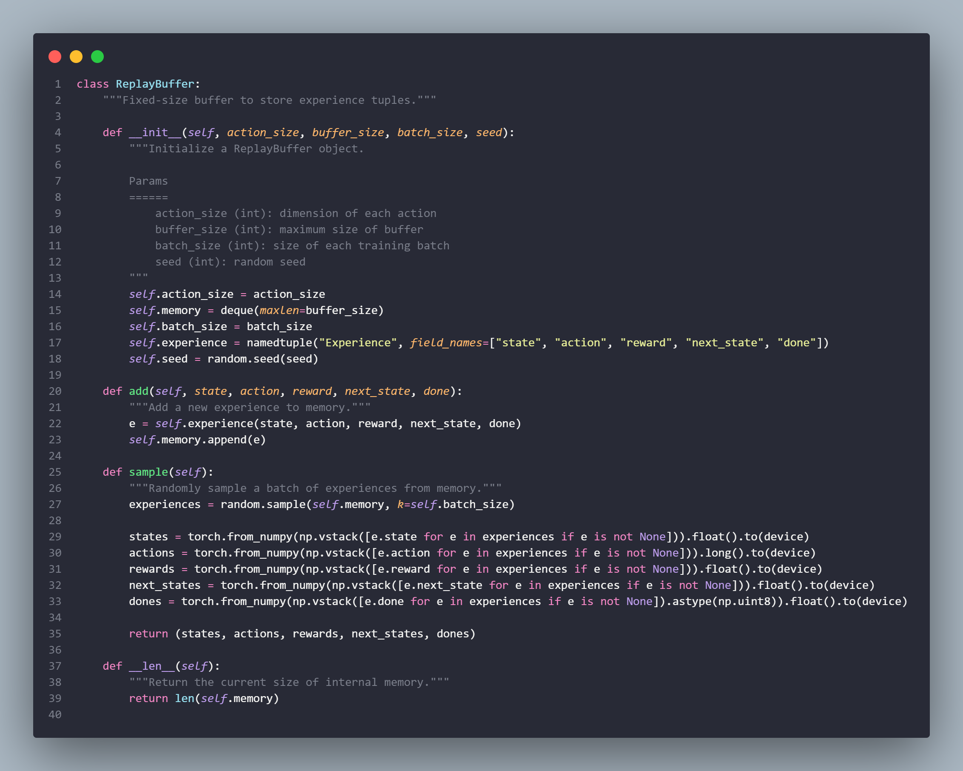
Modelling
Experience Replay:
Allows for the storage and reuse of previously experienced states, actions and rewards
Can be used to help an agent learn faster and more efficiently by re-experiencing past experiences
Can be used to break the correlation between successive states in the environment
Tradeoffs:
Can be computationally expensive
Can potentially lead to overfitting
Can lead to action repetition and slow down the learning process
In our case, experience replay could be beneficial for us, as it allows us to store and reuse previously experienced states, actions and rewards. This can lead to faster learning and allow us to break
the correlation between successive states in the environment.
However, it is important to note that it can be computationally expensive and can potentially lead to overfitting. Furthermore, it can lead to action repetition and slow down the learning process.
Singapore Polytechnic

Slide 9
Singapore Polytechnic
Baseline Model Evaluation
Where did it perform well?
Able to consistently identify and avoid obstacles in the environment
Able to accurately estimate their current state and position in the environment
Where did it fall short?
Unable to exhibit intelligent decision making, such as making calculated risks or balancing between short-term and long-term rewards
Unable accurately assess the trajectory of the lander and make corrections as needed
Unable to utilise the available resources efficiently and effectively.
Singapore Polytechnic

Slide 10
Hyperparameter Tuned Model
Architecture Overhaul:
From:
(fc1): Linear(in_features=state_size, out_features= 64, bias=True)
(fc2): Linear(in_features= 64, out_features=64, bias=True)
(fc3): Linear(in_features= 64, out_features=action_size,bias=True)
To:
(fc1): Linear(in_features=state_size, out_features=16, bias=True)
(fc2): Linear(in_features=16, out_features=32, bias=True)
(fc3): Linear(in_features=32, out_features=64, bias=True)
(fc4): Linear(in_features=64, out_features=128, bias=True)
(fc5): Linear(in_features=128, out_features=256, bias=True)
(fc6): Linear(in_features=256, out_features=action_size, bias=True)
Target Network Update Frequency:
The target network update is the frequency at which the weights of the target network are updated with the weights of the main network. A higher frequency of update will result in more frequent updates and faster convergence of the Q value estimation.
However, a higher frequency of update can also lead to overfitting and instability in the Q value estimation. Therefore, by reducing the target network update from 5 to 7, we can reduce the frequency of updates and help ensure more stable and accurate Q value estimations.
Singapore Polytechnic
Notes:
To increase the complexity of the Q value estimation: The increased number of layers in the new architecture can help improve the accuracy of the Q value estimation. This is because the increased number of layers allows the neural network to capture more subtle patterns in the data and more accurately predict the optimal action.
To make the Q value estimation more robust: The additional layers in the new architecture can provide more robustness to the Q value estimation. This is because the increased number of layers allows the neural network to better handle variations in the input data, making it more resilient to changes in the environment.
To increase the speed of the training process: The increased number of layers in the new architecture can help speed up the training process. This is because the increased number of layers allows the neural network to process more data faster, resulting in faster convergence of the Q value estimation.

Slide 11
Singapore Polytechnic
Hyperparameter Tuned Model Evaluation
Where did it perform well?
Where did it perform well?
Able to accurately identify and avoid obstacles in the environment while navigating to the landing site.
Able to accurately estimate their current state and position in the environment, while exhibiting intelligent decision making such as making calculated risks and balancing between short-term and long-term rewards.
Able to accurately assess the trajectory of the lander and make corrections as needed.
Able to efficiently and effectively utilise the available resources.
Singapore Polytechnic

Slide 12
Metrics
Singapore Polytechnic
Epsilon: Epsilon is a probability that is used to decide the action taken by the agent. Lower values of epsilon will lead to more exploration and higher values will lead to more exploitation. This metric helps us measure how much exploration is taking place.
Average_score: This metric captures the average score achieved by the agent over a number of episodes. This metric helps us understand how consistent the agent's performance is.
Average reward: This metric captures the average reward achieved by the agent over a number of episodes. This metric helps us understand how the agent is performing and how effective the agent's actions are.
Singapore Polytechnic

Slide 13
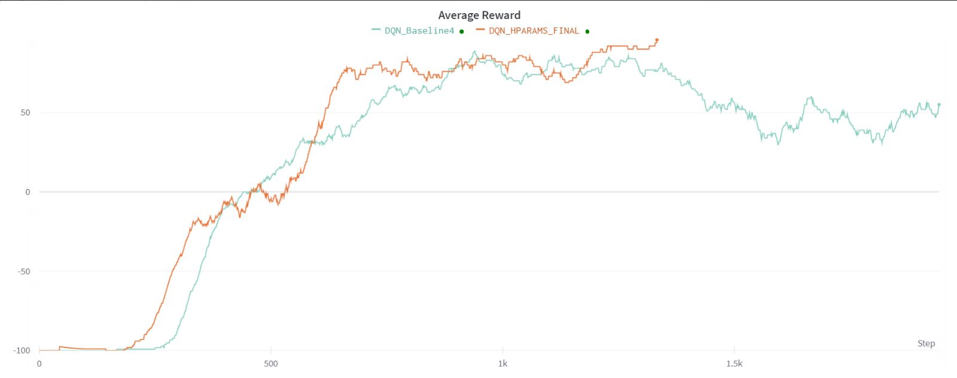
Metrics
Singapore Polytechnic
Singapore Polytechnic

Slide 14
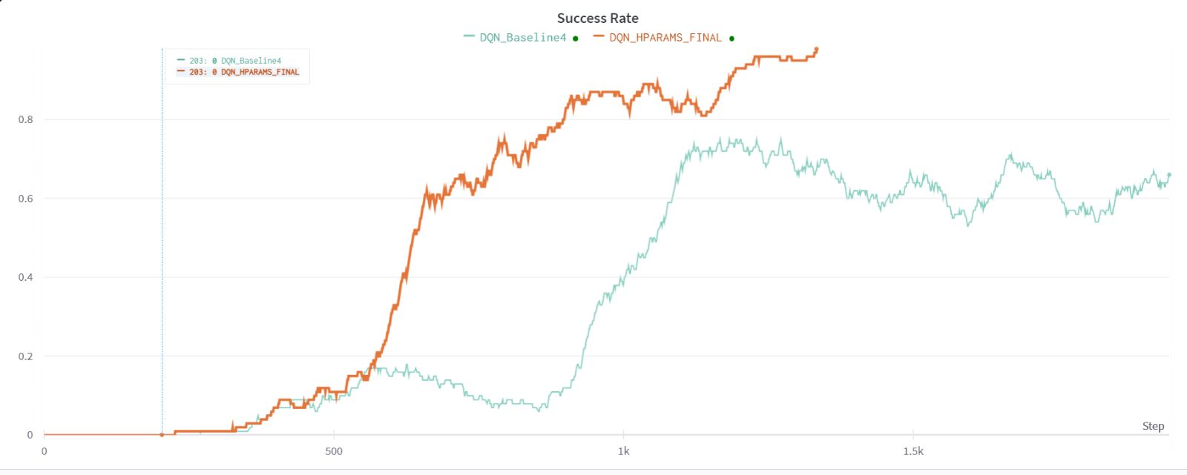
Metrics
Singapore Polytechnic
Singapore Polytechnic

Slide 15
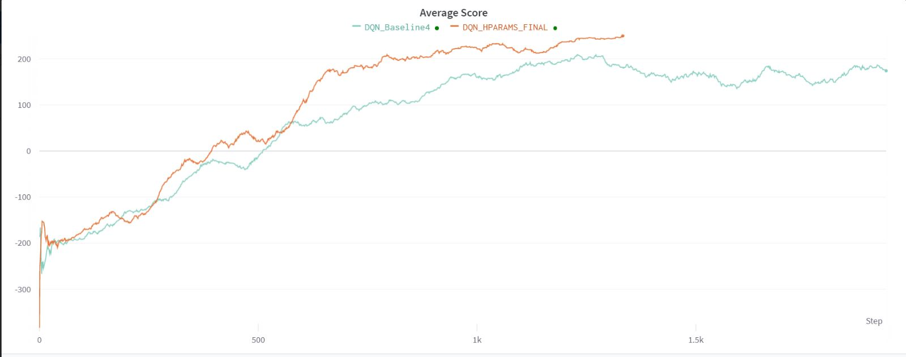
Metrics
Singapore Polytechnic
Singapore Polytechnic

Slide 16
Conclusion
Singapore Polytechnic
In conclusion, the Deep Q-Network (DQN) has been successfully tested on the Lunar Lander environment.
The evaluation was based on the average score, epsilon, and average reward.
The results from the evaluation showed that the DQN was able to successfully reach the goal and achieve good scores. The exploration was also satisfactory as the epsilon values were low and the coverage was high.
The agent was consistent in its performance as the average score was high. Lastly, the agent was able to rank the actions correctly as indicated by the NDCG metric. Thus, the DQN was able to successfully solve the Lunar Lander environment.
Singapore Polytechnic

